Slide 1





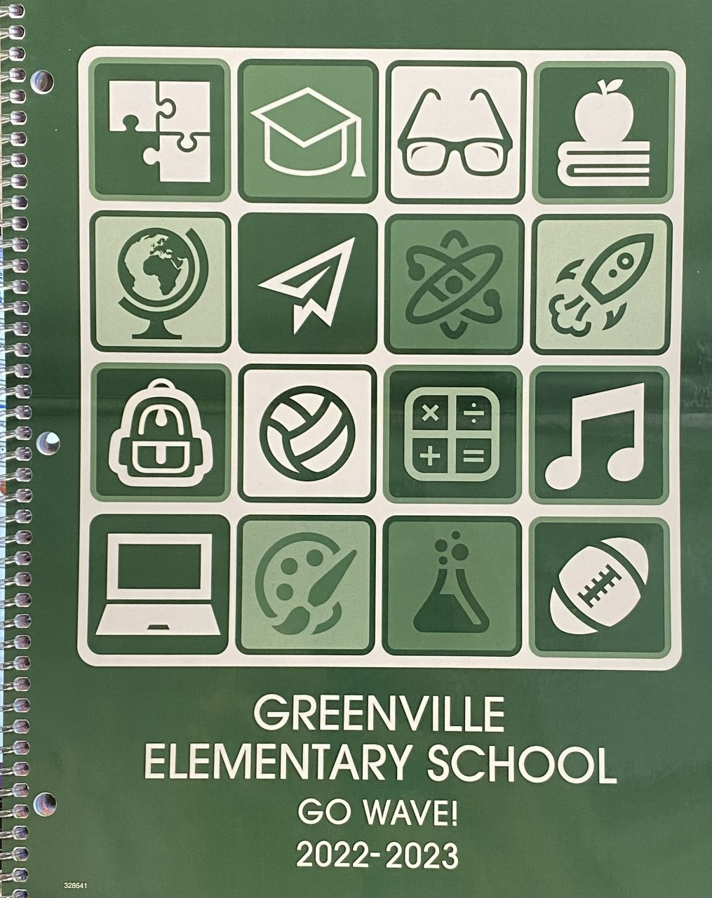

Meet Your Teacher
My name is Mrs. Kraft,
and I am so excited to
be your teacher! Below
is a little about me.
Family: My husband,
Josh, and I are the
proud parents of two
little girls – Katie who is seven, and Kennedy who is five.
Education: I attended Ohio University, majoring in Early Childhood Education, and later mastered in Technology in Education through Lesley University.
Experience: I taught for fourteen years in South Carolina (both second and third grades) and have taught third grade for Greenville the last three years. This year, I will be teaching 3rd grade Language Arts, including reading, writing, grammar, and word work.
Favorites: I love spending time with my family, coffee, football (Ohio State and Cleveland Browns), and art (mostly doodling or painting).
I look forward to getting to know you better. I know we are going to have a great year!
Mrs.
Mrs. Miller
Mrs.
The Third Grade Wave
November 2022
Important Dates
November 4th – Report Cards Go Home
November 8th, 10th, and 15th – Parent / Teacher Conferences
November 23rd - 25th – Thanksgiving Break (No School)
iPads - Important
Please be sure your child is charging their iPad each night. Students will utilize various educational apps to build skills in content areas such as reading and math, while also growing in their technological skills. We use them all throughout the day, so having a charged iPad is very important.
Planner and Folder
Your child’s planner
and orange take-
home folder should
come home each
night. Assignments are written in your child’s planner each week. Homework and papers that need your attention will be put in the “Return to School” side of the orange folder for you to review. Thank you for helping your child build the routine of checking both nightly. We greatly appreciate it!
Dojo
If you still need to join Dojo, please let me know.
This app is a wonderful tool for parent / teacher communication.
Daily Reading
Students are encouraged to read a minimum of 20 minutes each school night. Completing this reading has a positive impact on your child’s success in third grade! If you need books, please let me know
Canvas
Greenville City Schools will utilize the learning management system, Canvas, again this year.

Slide 2


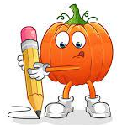

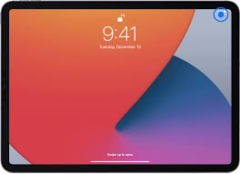
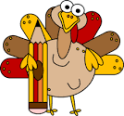

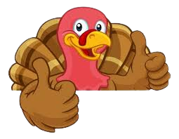
Reading
This month, we will be exploring a variety of fiction and nonfiction texts.
With the nonfiction texts, we will build our skills in:
Answering questions using the text for support.
Determining the main idea and retelling the key details that support it.
Using text features to better understand information presented by an author.
Understanding an author’s point of view compared to our own.
As we read the fictional pieces, we will:
Identify figurative language and how it adds meaning and interest to a text.
Analyze how characters’ motivations, feelings, and actions can affect the sequence of events in a story.
When your child reads at night, asking them questions about their chosen texts can help to reinforce the concepts above. These quick conversations can make a huge difference!
Writing
In November, students will continue to build skills in paragraph writing in which they respond to a prompt. Our focus will be opinion writing. Student will practice using text evidence from a given passage to support their paragraph response.
Word Study
Students will continue to bring home a spelling list with a targeted phonics skill each week. While we practice these skills and the words in class,
please also have your child
study their words
at home, and ask
them to explain
our phonics
concept to you.
Grammar
Grammar instruction is being taught in multiple ways. One, through direct grammar instruction where specific skills are practiced. The other is through our writing and reading response time. Grammar concepts are reviewed and reinforced while writing our responses, focusing on complete sentences that have proper grammar, capitalization, and punctuation.
Classroom Harvest Party
Our Harvest Party will be on Tuesday, November 22nd (the day before Thanksgiving Break).There will be more information to come!

