Slide 1
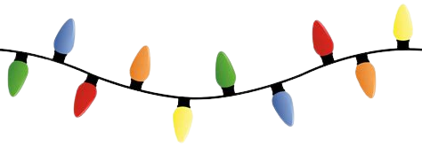
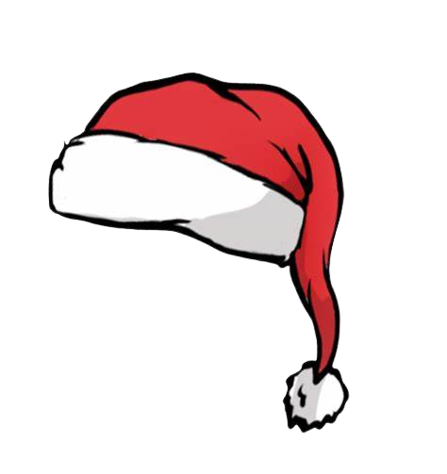
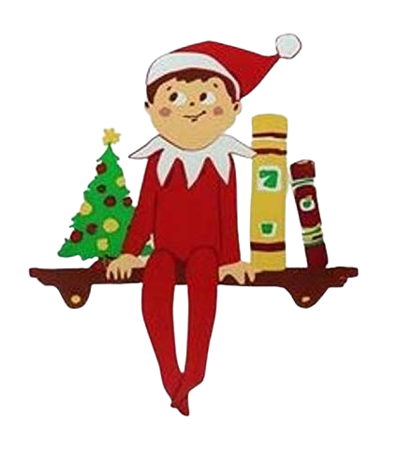
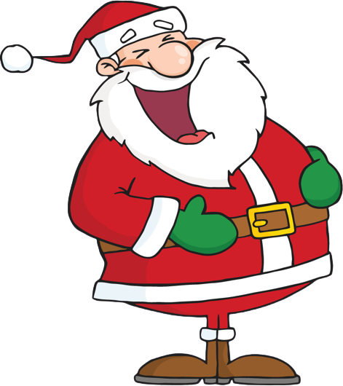
Mrs. Miller’s
The Third Grade Wave
December 2022
Important Dates
December 19th – Christmas Party
There will be more information to come.
December 20th – January 2nd – Winter Break
No School
January 3rd – School Resumes
Learning Targets - December
Reading
With fictional texts, we will practice summarizing and identifying themes. We will also be working to recognize figurative language within a text and discuss how it can add meaning for readers. Finally, students will practice sequencing story events by using text evidence to support their answers.
Writing
This month, we will be finishing our opinion writing study. We have been learning how to write opinion paragraphs, using text evidence as support for our opinions. Students have practiced writing paragraphs that clearly introduce their opinion, support their opinions with relevant details, use transition words to connect ideas, and provide a concluding statement. We also incorporate grammar and phonics concepts into each writing lesson.
Special Notes
THANK YOU to everyone who sent in treats in for our Harvest Party! The kids really enjoyed them!
Information about our Christmas Party will be coming soon.
Please continue reading with your child each night. Also, a great way to help your child is to go over any papers sent home.
Jokes
Your kids LOVE to tell jokes! Here are a few you can tell them…
❄️ How do elves respond when Santa takes attendance?
“Present!”
❄️ What do you call an obnoxious reindeer?
Rude-olph.
❄️ What do grapes sing at Christmas?
'Tis the season to be jelly.

